Slide 1



FPT Software
ANDROID TRAINING
LESSON 11
Version 0.1

Slide 2
Agenda
Building a custom View
The Paint Class
The Canvas class
Rendering continuously in the UI thread
The SurfaceView
Sprite animation
2/11/2012
Android Insights - 3
<number>/18

Slide 3
Building a custom View
Consider building a custom View, If your application does not require a significant amount of processing or frame-rate speed (perhaps for a chess game, a snake game, or another slowly-animated application.
To start:
  Extend the android.view.View
  Override the onDraw(Canvas c) method.
  Make sure that main Activity loads the view.
  public class Draw2d extends View{
    public Draw2d(Context context) {
      super(context);
    }
    @Override
    protected void onDraw(Canvas c){
    super.onDraw(c);
    }
  }

Slide 4
Create a custom View
Put the following lines just after the super.onCreate(savedInstanceState) :
@Override
public void onCreate(Bundle savedInstanceState) {
super.onCreate(savedInstanceState);
requestWindowFeature(Window.FEATURE_NO_TITLE);
setContentView(new Draw2d(this));
}

Slide 5
The Paint Class
The Paint class holds the style and color information about how to draw geometries, text and bitmaps.
Some functions:
  setColor(int color)
  Set the paint's color.
  setAntiAlias(boolean aa)
  Helper for setFlags(), setting or clearing the ANTI_ALIAS_FLAG bit AntiAliasing smooths out the edges of what is being drawn, but is has no impact on the interior of the shape.
  setStyle(Paint.Style style)
  Set the paint's style, used for controlling how primitives' geometries are interpreted (except for drawBitmap, which always assumes Fill).
  setTextSize (float textSize)
  Set the paint's text size. This value must be > 0

Slide 6
The Canvas Class
The Canvas class holds the "draw" calls. To draw something, you need 4 basic components: A Bitmap to hold the pixels, a Canvas to host the draw calls (writing into the bitmap), a drawing primitive (e.g. Rect, Path, text, Bitmap), and a paint (to describe the colors and styles for the drawing).

Slide 7
The Canvas Class
Draw a circle
  drawCircle(float cx, float cy, float radius, Paint paint)
  Draw the specified circle using the specified paint.
  paint.setAntiAlias(true);
  paint.setColor(Color.BLUE);
  c.drawCircle(80, 20, 15, paint);

Slide 8
The Canvas Class
Draw a rectangle
  drawRect(float left, float top, float right, float bottom, Paint paint)
  Draw the specified Rect using the specified paint.
  paint.setColor(Color.GREEN);
  c.drawRect(20, 5, 50, 100, paint);

Slide 9
The Canvas Class
Draw text
  drawText(String text, float x, float y, Paint paint)
  Draw the text, with origin at (x,y), using the specified paint.
  paint.setColor(Color.RED);
  paint.setStyle(Paint.Style.FILL);
  paint.setAntiAlias(true);
  paint.setTextSize(30);
  c.drawText("Me like painting!", 30, 200, paint);

Slide 10
The Canvas Class
Draw a resource (image)
  drawBitmap(Bitmap bitmap, float left, float top, Paint paint)
  Draw the specified bitmap, with its top/left corner at (x,y), using the specified paint, transformed by the current matrix.
  Resources res = this.getResources();
  Bitmap bitmap = BitmapFactory.decodeResource(res, R.drawable.icon);
  c.drawBitmap(bitmap,90 ,200 , paint);

Slide 11
The Canvas Class
Rendering continuously in the UI thread
  You need a View to redraw itself when an update is needed, call invalidate();
  When calling invalidate() in onDraw(), rendering will be continuously in the UI thread
    protected void onDraw(Canvas canvas) {
    // … all drawing
    invalidate();
    }

Slide 12
The SurfaceView
The SurfaceView is a special subclass of View that offers a dedicated drawing surface within the View hierarchy.
The aim is to offer this drawing surface to an application's secondary thread, so that the application isn't required to wait until the system's View hierarchy is ready to draw. Instead, a secondary thread that has reference to a SurfaceView can draw to its own Canvas at its own pace.

Slide 13
The SurfaceView
To begin:
  Create a new class that extends SurfaceView.
  Should also implement SurfaceHolder.Callback. This subclass is an interface that will notify you with information about the underlying Surface, such as when it is created, changed, or destroyed.
  Inside your SurfaceView class is also a good place to define your secondary Thread class, which will perform all the drawing procedures to your Canvas.
  Access to the underlying surface is provided via the SurfaceHolder interface, which can be retrieved by calling getHolder()

Slide 14
The SurfaceView
To draw something on the SurfaceView, place the codes in-between surfaceHolder.lockCanvas() and surfaceHolder.unlockCanvasAndPost(canvas).

Slide 15

Sprite Animation
An animation is showing a sequence of images in order
Example:
  a walk animation
  Combined from frames:

Slide 16
Sprite Animation
Creating a new class which will represent an animated sprite
  public class MySprite{
    private Bitmap mAnimation;
    private int mXPos;
    private int mYPos;
    private Rect mSRectangle;
    private int mFPS;
    private int mNoOfFrames;
    private int mCurrentFrame;
    private long mFrameTimer;
    private int mSpriteHeight;
    private int mSpriteWidth;

Slide 17
Sprite Animation
mAnimation: hold the actual bitmap containing the animation
mXPos/mYPos: hold the X and Y screen coordinates for where we want the sprite to be on the screen. These refer to the top left had corner of the image.
mSRectangle: the source rectangle variable and controls which part of the image we are rendering for each frame.
mNoOfFrames: the number of frames in the sprite sheet we are animating.
mCurrentFrame: keep track of the current frame.
mSpriteHeight/mSpriteWidth: the height and width of an Individual Frame not the entire bitmap.

Slide 18
Sprite Animation
mFrameTimer: this is the java timestamp of the last frame change in the walking sequence. Note that this is not the game FPS but the walking FPS. If we want Elaine to perform a complete walk cycle in a second we set the frame rate for walking to 5 because we have 5 frames. To get a really smooth animation we need 30 frames but it’s not the point now.
mFPS is time in milliseconds that represents the period of time a frame is being displayed. If the cycle completes in 1 second that means for 5 frames the period will be 0.2 seconds. That is, each frame will be displayed for 0.2 seconds.

Slide 19
Sprite Animation
public void Update(long GameTime) {
  if(GameTime > mFrameTimer + mFPS ) {
    mFrameTimer = GameTime;
    mCurrentFrame +=1;
    if(mCurrentFrame >= mNoOfFrames) {
      mCurrentFrame = 0;
    }
  }
  mSRectangle.left = mCurrentFrame * mSpriteWidth;
  mSRectangle.right = mSRectangle.left + mSpriteWidth;
}
The update method increments the frame if the passed in time (which is the system time when the update method was called) is greater than the last time (mFrameTimer) the frame was updated plus the period of the next update.
If the next frame is beyond the last, we reset the cycle.

Slide 20
Sprite Animation
  public void draw(Canvas canvas) {
  Rect dest = new Rect(getXPos(), getYPos(), getXPos() + mSpriteWidth, getYPos() + mSpriteHeight);
  canvas.drawBitmap(mAnimation, mSRectangle, dest, null);
  }
  Draw(): display sprite animation

Slide 21
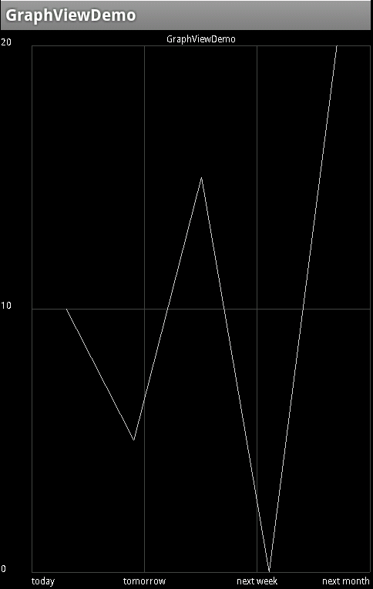
Homework
Create Graph view with inputs:
  X-axis labels
  Y-axis labels
  values

Slide 22
Thank you!

